Slide 1
Inferential Statistics
Rabail Tahir

Slide 2
Learning Outcomes
Define inferential statistics.
Explain the difference between a sample and a population.
Explain how confidence intervals work.
List and explain the steps in hypothesis testing.
Explain the difference between the null hypothesis and the alternative hypothesis.
Explain the difference between a probability value and the significance level.

Slide 3
What is Inferential statistics?
It is the study of the abstract relationship between sample and population.
As a Data Scientist , you will need to keep all your bias aside and do not jump to conclusions.
Inferential Statistics helps us do the following:
Estimate parameters
Construct confidence intervals
Test hypothesis
Make decisions
Develop strategies
Forecasting

Slide 4
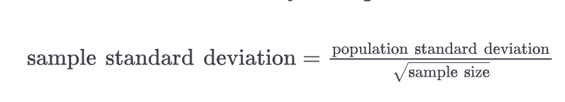
The Central Limit theorem
The Central Limit Theorem states that when large samples are taken from populations, and are plotted after calculating their means, the distribution that results from that is the same as Normal Distribution.
Some important points:
The mean of the sample means is equal to the population mean.
If the population is normal, then the sample means will be normal.
If the population is not normal, but the sample size is greater than 30, the sample means will still roughly form a normal distribution.
The standard deviation of the sample means equals the population standard deviation divided by the square root of n:

Slide 5
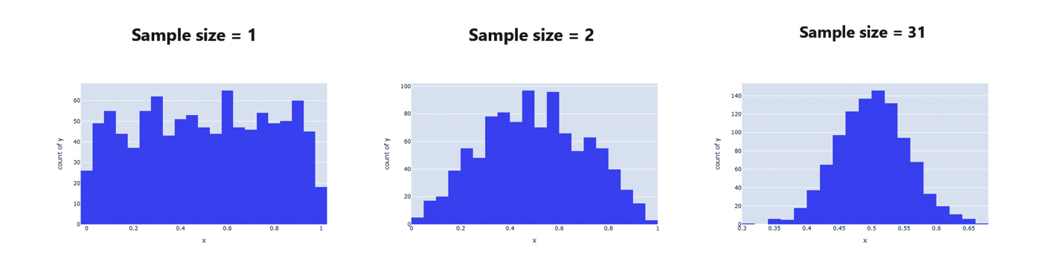
Larger sample sizes approach Normal Distribution

Slide 6
Confidence Interval
“A confidence interval is a range calculation showing how confidently we believe a sample mean (or other parameter) falls in a range for the population mean.”
For example, “Based on a sample of 31 golden retrievers with a sample mean of 64.408 and a sample standard deviation of 2.05, I am 95% confident that the population mean lies between 63.686 and 65.1296” .
Confidence interval helps you determine how much uncertainty there is with any statistical measurement.
It helps us to know how much confident we can be for any statistical result.
Confidence Interval uses the concept of Margin of Error.

Slide 7
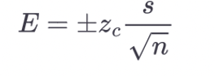
Margin of Error
Margin of error (E), which is the range around the sample mean that contains the population mean at that level of confidence.
Steps to calculate Margin of Error:
Calculate the critical value, which can be either z-score or t-score. (T-score is used when sample size is under 30 and population standard deviation is also unknown)
Find the standard deviation
Apply these values in the following formula

Slide 8
How to calculate Critical Z value for a given confidence level
Step 1: Determine the confidence level, denoted C, where C is a number (decimal) between 0 and 100.
Step 2: Obtain the confidence level, denoted α by evaluating α=1−(c/100)
Step 3: Use the z-table (or a calculator) to obtain the z-score Zα/2.
Z-table (https://users.stat.ufl.edu/~mripol/STA2023/Z-table.pdf)

Slide 9
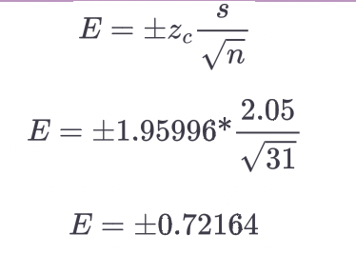
Margin of Error Example
Recall that our sample of 31 golden retrievers has a mean of 64.408 and standard deviation of 2.05. The formula to get this margin of error is:

Slide 10
If we apply that margin of error against the sample mean, we finally get the confidence interval!

Slide 11
Example
A biologist wants to estimate the mean height of all of the trees in a park. In a sample of 455 of the park's trees, the mean height is 39.2 feet. The biologist wants a 99% confidence interval for the true mean height of all of the trees in the park. What z-score should be used when constructing the interval?

Slide 12
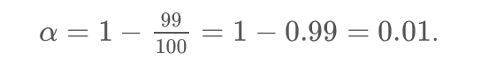
Solution
Step 1 : Determine confidence level which is 99%
Step 2: Calculate significance level ,
Step 3 : Use the z-table to obtain the z-score for z(𝛼/2) The z score z(𝛼/2)=𝑧(0.01/2)=𝑧(0.005) is the number on the horizontal axis that has the area 0.005 to its right, so it has area 1 – 0.005 = 0.995 to its left. Using the z table gives z(0.005) = 2.575

Slide 13
Understanding P- values
P-value, the probability of something occurring by chance rather than because of a hypothesized explanation.
When we set up any experiment, we have to consider the possibility of random luck influencing the results of the experiment.
This helps us define our null hypothesis, that any particular variable had no influence on the results, and that any positive results are due to random luck.
On the other hand, it can also help us form the alternative hypothesis that the particular variable did indeed influence the results.
The threshold for statistical significance is a p-value of 5% or less.

Slide 14
P-value
P-Value is used in Hypothesis testing to accept or reject the null hypothesis.
A small P-value means that null hypothesis should be rejected.
P values are expressed as decimals.
A smaller P-value implies that your results are “significant” and are not a result of just random luck and there is a variable influencing it.

Slide 15
Alpha values
Alpha values are values that are controlled by the researcher and are related to confidence levels.
Alpha value = 100% - Confidence level
You calculate Alpha value by subtracting the confidence level from 100%.
For example, if you want to be 98% confident, the alpha value will be equal to 2%.
When you run the test or the experiment, it will give you the p value, which you then compare to the alpha value.
If p – value < = alpha value, hypothesis is rejected, else if its greater than the alpha value, the alternative hypothesis is weak.

Slide 16
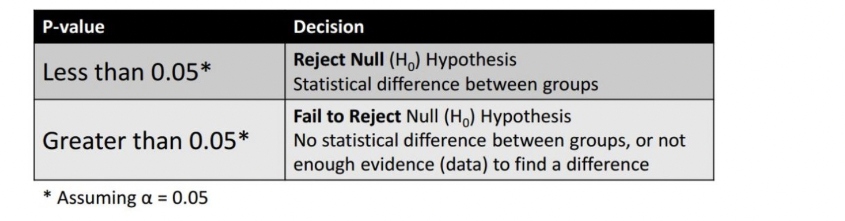
How are P-values calculated?
Can be calculated using P – value table or any statistical software.
It also depends on the statistical test you are using to test your hypothesis.
P – value is always between 0 and 1.

Slide 17
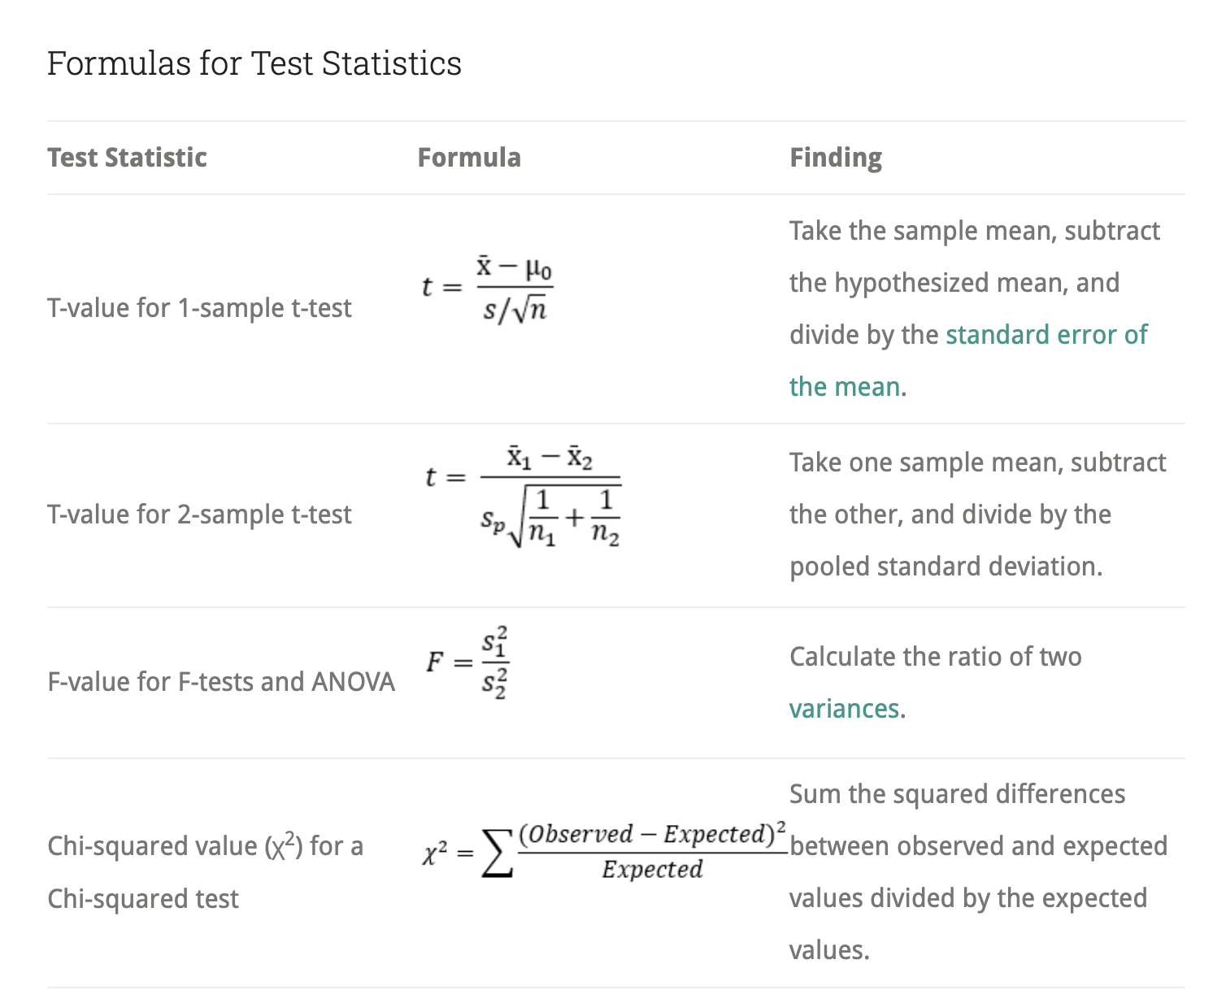

Slide 18
Hypothesis Testing
Hypothesis testing are all the methods and practices used by a researcher to prove or reject a hypothesis by using the sample and population data.
Null hypothesis is assuming that the particular event will not occur. It is represented by H0 (H-naught).
Alternative hypothesis is the logical opposite of the null hypothesis and is represented by H1.

Slide 19
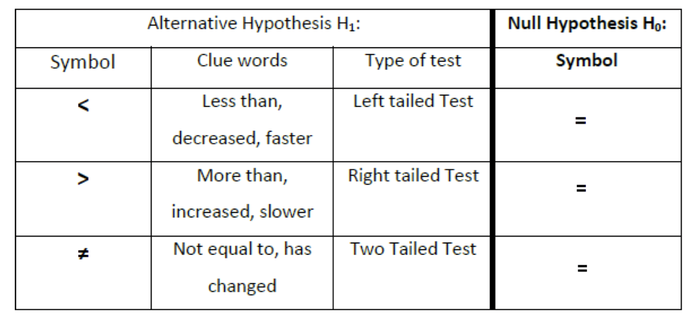

Slide 20
Examples
We want to test whether the mean GPA of students in American colleges is different from 2.0 (out of 4.0). The null and alternative hypotheses are: H₀: μ = 2.0 H_{a}: μ ≠ 2.0
We want to test if college students take less than five years to graduate from college, on the average. The null and alternative hypotheses are: H₀: μ ≥ 5 H_{a}: μ < 5

Slide 21
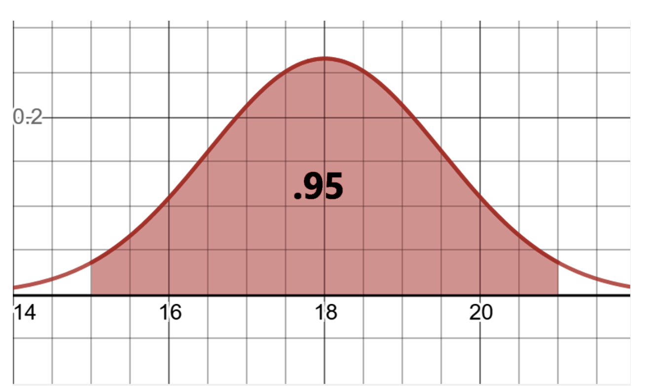
Understanding Hypothesis testing
Lets take an example of recovery time and drug testing for cold.
Studies suggest that the mean recovery time for common cold is 18 days, with a standard deviation of 1.5 days.
95% chance of recovery between 15 to 21 days

Slide 22
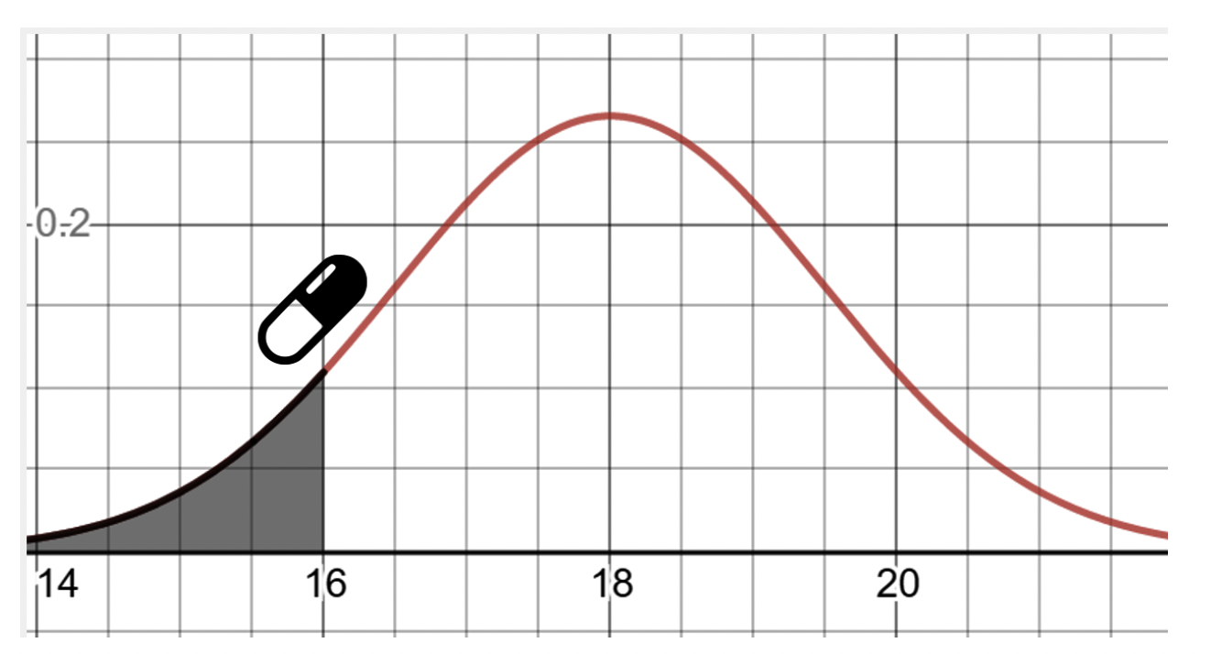
Understanding Hypothesis testing
2.5% chances that the recovery will be less than 15 days and 2.5% chances that the recovery will be more than 21 days.
A new drug was tested on a group of 40 people, and it took them an average of 16 days to recover.

Slide 23
Null hypothesis: Did the drug not work and the short recovery period was just a coincidence?
Alternate hypothesis: Does the drug show a significant result and works?
There are 2 types of tests to calculate this, one tailed test and two tailed test.

Slide 24
One tailed test
In one tailed test we hypothesize around the mean using inequalities.
To reject our null hypothesis, we need to show that our sample mean of the patients who took the drug is not likely to have been coincidental. Since a p-value of .05 or less is traditionally considered statistically signficant, we will use that as our threshold.
We only check one tail on the normal distribution curve in a one tailed test. In this example we will calculate the x – value with 5% of area behind it (since 0.05 is the p-value)

Slide 25
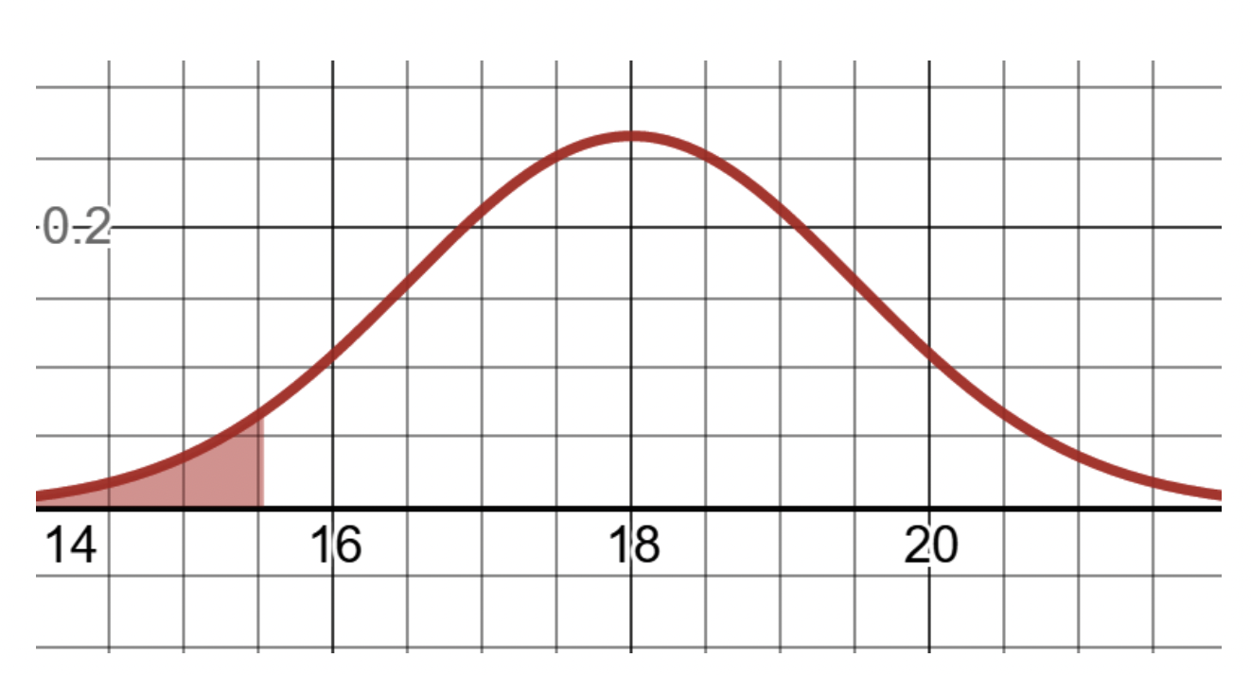
One tailed test

Slide 26
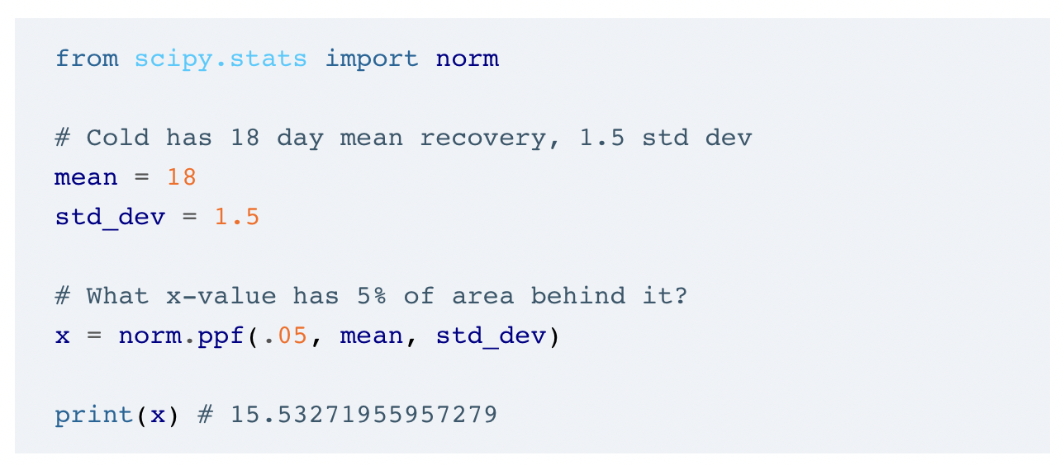
Python code for getting x-value with 5% of area behind it

Slide 27
One tailed test
Therefore, if we achieve an average 15.53 or fewer days of recovery time in our sample group, our drug is considered statistically significant enough to have shown an impact. However, our sample mean of recovery time is actually 16 days and does not fall into this null hypothesis rejection zone. Therefore, the statistical significance test has failed.

Slide 28
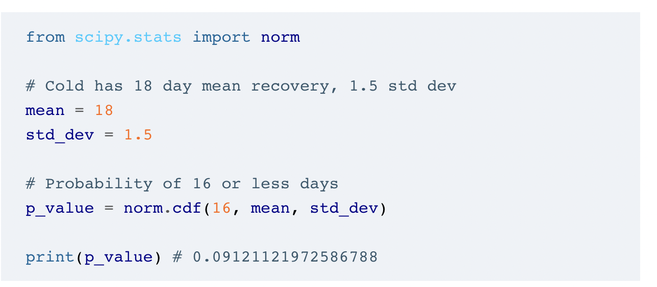
The area up to that 16-day mark is our p-value, which is .0912, and we calculate it in Python.
Since the p-value of .0912 is greater than our statistical significance threshold of .05, we do not consider the drug trial a success and fail to reject our null hypothesis.

Slide 29
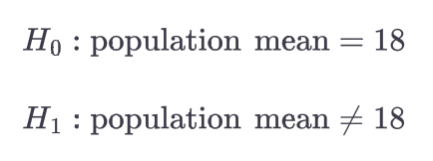
Two – Tailed test
In two tailed test we check at both tails of the Normal distribution curve.
It is a better practice.
We spread the p value statistical significance to both tails.
Instead of using inequalities , we use equal and not equal.

Slide 30
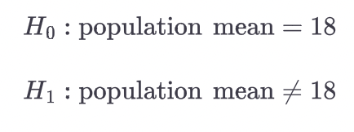
Two Tailed test example
Using the same example, as the one tailed test.
Our hypothesis is now whether the drug had any impact on the cold recovery time or not.

Slide 31
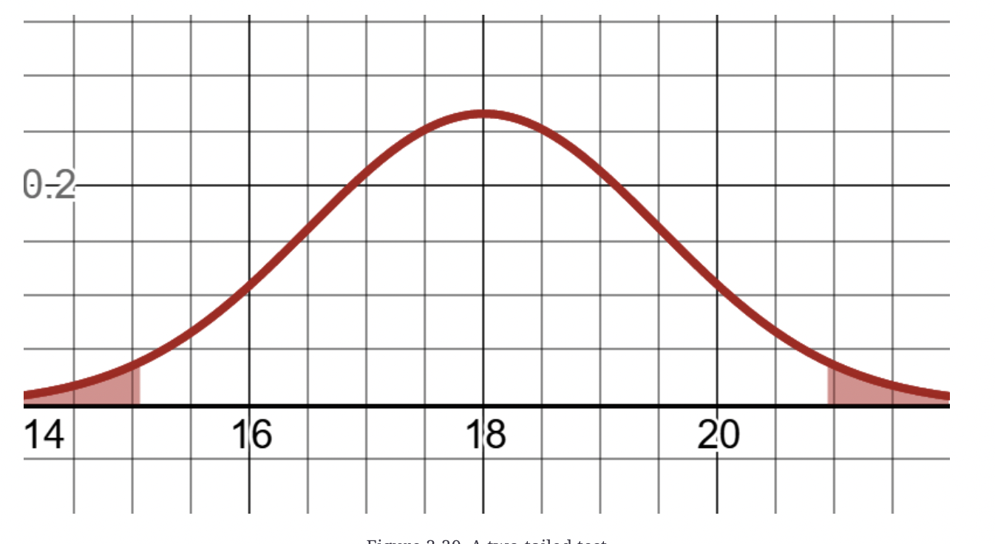
Two Tailed test
“We spread our p-value statistical significance threshold to both tails, not just one. If we are testing for a statistical significance of 5%, then we split it and give each 2.5% half to each tail. If our drug’s mean recovery time falls in either region, our test is successful and we reject the null hypothesis.”

Slide 32
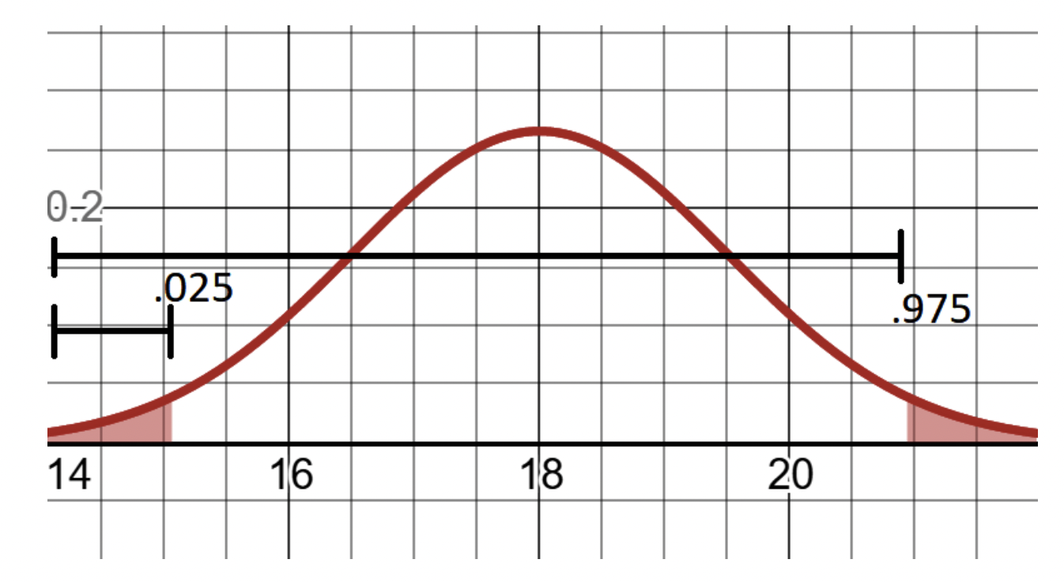
Upper tail, we take 0.975 and lower tail, 0.25

Slide 33
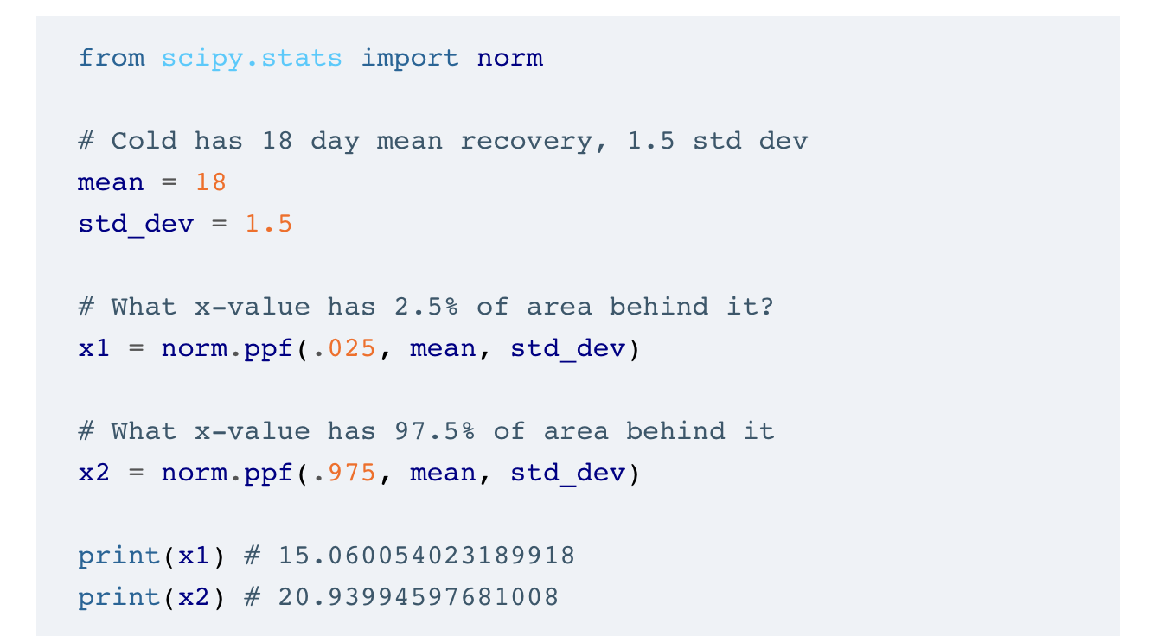
Calculating a range for a statistical significance of 5%

Slide 34
Results
The sample mean value for the drug test group is 16, and 16 is not less than 15.06 nor greater than 20.9399.
So like the one-tailed test, we still fail to reject the null hypothesis.
Our drug still has not shown any statistical significance to have any impact

Slide 35
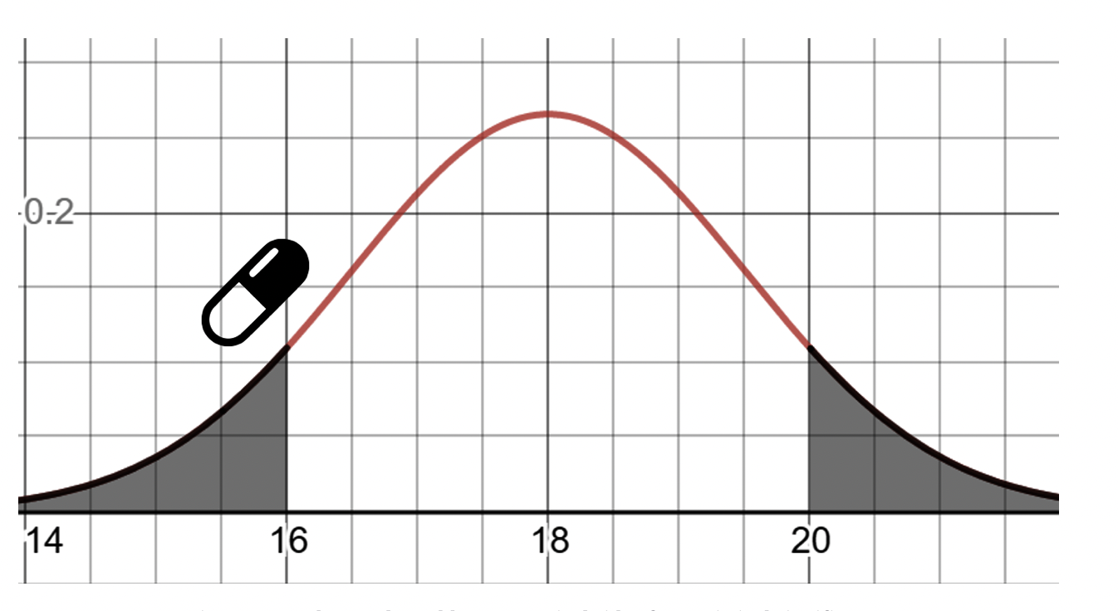
What about the P value?
When we sum both those areas, we get a p-value of .1824. This is a lot greater than .05, so it definitely does not pass our p-value threshold of 0.05

Slide 36
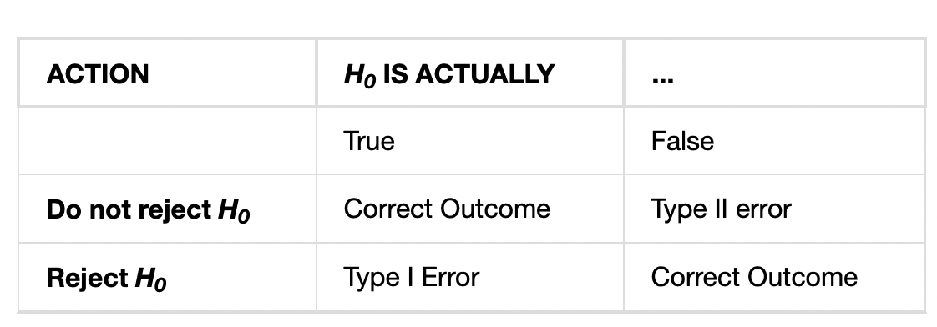
Errors
When you perform a hypothesis test, there are four possible outcomes depending on the actual truth (or falseness) of the null hypothesis H₀ and the decision to reject or not. The outcomes are summarized in the following table:

Slide 37
Errors
Each of the errors occurs with a particular probability. The Greek letters α and β represent the probabilities.
α = probability of a Type I error = P(Type I error) = probability of rejecting the null hypothesis when the null hypothesis is true.
β = probability of a Type II error = P(Type II error) = probability of not rejecting the null hypothesis when the null hypothesis is false.
α and β should be as small as possible because they are probabilities of errors. They are rarely zero.

Slide 38
Example
Suppose the null hypothesis, H₀, is: The victim of an automobile accident is alive when he arrives at the emergency room of a hospital.
Type I error: The emergency crew thinks that the victim is dead when, in fact, the victim is alive. Type II error: The emergency crew does not know if the victim is alive when, in fact, the victim is dead.
α = probability that the emergency crew thinks the victim is dead when, in fact, he is really alive = P(Type I error). β = probability that the emergency crew does not know if the victim is alive when, in fact, the victim is dead = P(Type II error).
The error with the greater consequence is the Type I error. (If the emergency crew thinks the victim is dead, they will not treat him.)

Slide 39

Any questions

